Slide 1
CH-8
Introduction to Other Databases

Slide 2
Database-System Architectures
A database system runs on a computer, so the computer’s architecture affects how the database works.
Three major computer concepts affect database architecture:
Networking → Client–Server Databases
What is Networking?
When many computers connect to each other.
What happens because of networking?
Some work can be done on server computers, and some work on client computers.
Result?
Client–Server database systems Client = Your laptop/mobile Server = A powerful computer storing the main database
Client sends request → Server processes → Client receives result

Slide 3
2. Parallel Processing → Parallel Databases
What is parallel processing?
A computer has many processors (CPU cores) that can work at the same time.
Why do we use it?
To run transactions faster
To run many queries at the same time
To break a big query into smaller parts and process them in parallel
Result?
➡ Parallel Database Systems They use multiple processors to speed up query processing.

Slide 4
3. Distribution → Distributed Databases
What is distribution?
Data is stored across multiple locations (different sites/cities/countries).
Why store data in multiple places?
Data stays close to where it is needed
Faster local access
Backup if one site is damaged (fire, flood, disaster)
Result?
➡ Distributed Database Systems Multiple database servers at different places but working together as one system.

Slide 5
Types of Architectures
A. Centralized Systems
Everything runs on one single computer Examples:
A desktop database used by one person
A server with one main machine storing and processing everything
Features:
Simple
No networking
Best for single-user or small systems

Slide 6
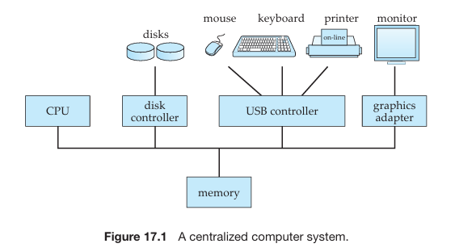

Slide 7
B. Client–Server Systems
Work is divided:
Server: Stores data, processes queries
Client: Provides user interface (forms, reports, SQL editor)
Example:
Your computer runs SQL Developer (client)
Oracle/MySQL server stores and processes queries
Tools like ODBC, JDBC help clients talk to servers.

Slide 8
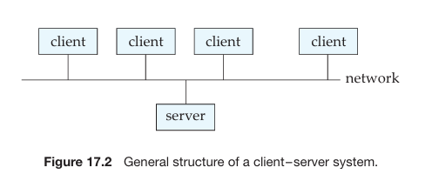

Slide 9
Summary
Concept | Meaning | Leads To
Networking | Multiple computers connected | Client–Server DB
Parallel Processing | Many processors working together | Parallel DB
Distribution | Data stored at multiple locations | Distributed DB

Slide 10
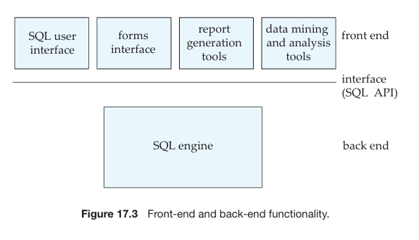
Server System Architectures
Server systems used in databases are mainly of two types:
Transaction-Server Systems (Query-Server Systems) - used in RDBM
Data-Server Systems - object oriented database system

Slide 11
1. Transaction-Server Systems (Query-Server Systems)
Meaning
Clients send requests (usually SQL queries) → Server executes the request → Server returns the result to the client.
How it works
Client sends a transaction (a set of SQL commands) to the server Example: SELECT * FROM Student WHERE Marks > 80;
Server processes the query (parsing, optimization, reading data, processing)
Server sends only the result back
Client displays the result
Interfaces used
Clients can send requests using:
SQL commands
Application interfaces (program APIs)
Where it is used
This is the most common architecture used in database systems (MySQL, Oracle, SQL Server).

Slide 12
A transaction server is a system where multiple processes work together to execute user queries and manage database operations.
It uses shared memory, so all processes can access common data like buffer pool, log buffer, lock table, etc.
Main Processes in a Transaction Server
Server Processes
These processes receive user queries (via SQL, JDBC, ODBC, etc.).
They execute the transaction and return the result.
Different DBMS designs:
One process per user session
OR one process with multiple threads
OR hybrid (many processes, each with many threads)

Slide 13
2. Lock Manager Process
Handles locking, which prevents conflicts when many users access data.
Responsible for: Lock grant Lock release Deadlock detection
3. Database Writer Process
Writes modified buffer blocks back to disk continuously.
Ensures updated data does not stay only in memory.
4. Log Writer Process
Writes log records from log buffer → stable storage.
Server processes only put log entries in memory; log writer writes them to disk.

Slide 14
5. Checkpoint Process
Performs periodic checkpoints.
Helps speed up recovery after a crash.
6. Process Monitor Process
Keeps track of other processes.
If a process fails: aborts its transactions restarts the failed process
Shared Memory Contains
All database processes access shared memory, which stores:
Buffer Pool (database blocks in memory)
Lock Table (to manage locks)
Log Buffer (log records waiting to be written)
Cached Query Plans (to reuse old plans and speed up queries)

Slide 15
Why Mutual Exclusion Is Needed
Since many processes access shared memory → they must not modify the same data at the same time.
Mutual exclusion ensures:
Only one process updates a data structure at a time
No one reads it while another is writing it
Implemented using:
Semaphores (OS feature)
OR atomic CPU instructions (faster)
These are also used to implement latches (lightweight locks).

Slide 16
How Locking Works in Shared Memory
Many systems avoid sending lock requests via messages (slow). Instead, server processes directly update the lock table in shared memory.
Two main differences from normal locking:
Must ensure mutual exclusion when accessing the lock table
If lock is not available:
The process waits
Lock release code signals waiting processes via semaphores
Even with shared-memory locking, deadlock detection is still done by the lock manager process.

Slide 17
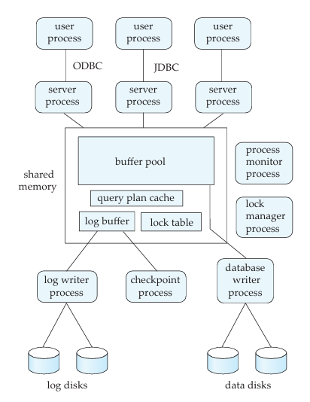

Slide 18
2. Data-Server Systems
Data-server systems are used mainly in local-area networks (LANs) where:
Clients and server both have good processing power
The network connection is fast
The tasks are computationally heavy
In this system, the server sends data to the client, the client processes it, and then sends results back. (This is the opposite of transaction servers, where processing happens mainly on the server.)
This requires the clients to have full database back-end functionality.
Why Data Servers Are Different
Communication between client ↔ server is slow (milliseconds) but memory access inside a computer is very fast (nanoseconds).
Because of this, some interesting issues arise.

Slide 19
Page Shipping vs Item Shipping
Item = tuple or object
Two approaches:
A. Item Shipping (fine-grained)
Sends one item at a time
Too much message overhead (slow)
B. Page Shipping (coarse-grained)
Sends an entire page that contains many items
Works like prefetching because it brings more data than asked
Faster because fewer messages
Page shipping is generally better.

Slide 20
2. Adaptive Lock Granularity
Server gives locks for whatever it sends to the client.
With page shipping, client gets a lock on the whole page, even if it needs only one item → too coarse.
This may block other clients unnecessarily.
Solution → Lock De-escalation
Server can ask client to return locks on prefetched items it doesn’t need.
Returned locks can then be given to other clients.

Slide 21
3. Data Caching at Client
Data shipped to a client can remain in the client cache even after the transaction ends.
Next transaction on the same client can reuse it.
But there is a problem → Cache Coherency
Client must check:
Is the cached data still valid?
Has another client updated the data?
Therefore, client must still talk to the server to check validity and get a lock.

Slide 22
4. Lock Caching
If clients mostly use different sets of data, locks can be cached on the client.
If the required lock is already in cache: No need to contact the server Faster access
But:
Server must track which client holds cached locks
If another client needs a conflicting lock: Server must call back the lock from the old client
Handling failures becomes complicated
Lock caching works across transactions, unlike lock de-escalation.

Slide 23
Parallel Systems
1. Meaning
Parallel systems use multiple processors and disks working simultaneously to improve the speed of processing and I/O operations.
2. Need for Parallel Database Systems
Used for applications that require:
Querying very large databases (terabytes)
Handling very high transaction rates (thousands per second)
Centralized or client–server systems are not powerful enough for such workloads.

Slide 24
3. Serial vs Parallel Processing
Serial processing: Tasks performed one after another.
Parallel processing: Multiple operations run at the same time, reducing time and increasing throughput.
4. Types of Parallel Machines
Coarse-grain parallel machines
Few powerful processors (2–4, or tens)
Available in most modern high-end systems
Massively parallel (fine-grain) machines
Hundreds or thousands of small processors
Used for large scientific or commercial databases

Slide 25
5. Performance Measures
Throughput
Number of tasks completed in a time period
Improves by running many transactions in parallel
Response Time
Time taken to complete a single task
Improves when large tasks are split into parallel subtasks

Slide 26
6. Benefits of Parallel Database Systems
Faster query processing
High transaction processing capacity
Better resource utilization
Improved availability and reliability

Slide 27
Parallel Database
we will discuss the overview of Parallel Databases and then will emphasize their needs and advantages, and then finally, will cover the performance measurement factor-like Speedup and Scaleup with examples. Let's discuss it one by one.
Parallel Databases : Nowadays organizations need to handle a huge amount of data with a high transfer rate. For such requirements, the client-server or centralized system is not efficient. With the need to improve the efficiency of the system, the concept of the parallel database comes in picture. A parallel database system seeks to improve the performance of the system through parallelizing concept.
Need : Multiple resources like CPUs and Disks are used in parallel. The operations are performed simultaneously, as opposed to serial processing. A parallel server can allow access to a single database by users on multiple machines. It also performs many parallelization operations like data loading, query processing, building indexes, and evaluating queries.

Slide 28
Advantages : Here, we will discuss the advantages of parallel databases. Let's have a look.
Performance Improvement - By connecting multiple resources like CPU and disks in parallel we can significantly increase the performance of the system.
High availability - In the parallel database, nodes have less contact with each other, so the failure of one node doesn't cause for failure of the entire system. This amounts to significantly higher database availability.
Proper resource utilization - Due to parallel execution, the CPU will never be idle. Thus, proper utilization of resources is there.
Increase Reliability - When one site fails, the execution can continue with another available site which is having a copy of data. Making the system more reliable.

Slide 29
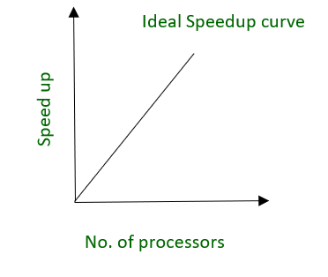
Performance Measurement of Databases : Here, we will emphasize the performance measurement factor-like Speedup and Scale-up. Let's understand it one by one with the help of examples.
Speedup - The ability to execute the tasks in less time by increasing the number of resources is called Speedup.

Slide 30
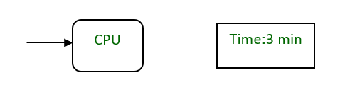
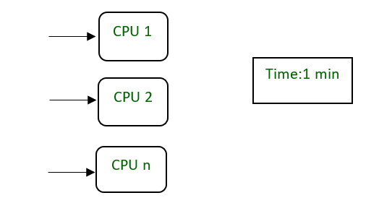
Example:

Slide 31
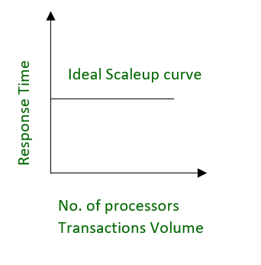
Scale-up -
The ability to maintain the performance of the system when both workload and resources increase proportionally.

Slide 32
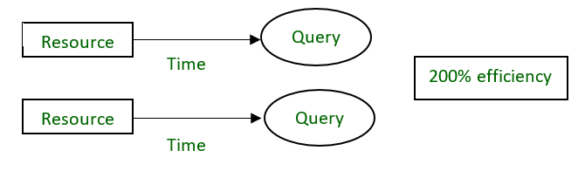
Example -
20 users are using a CPU at 100% efficiency. If we try to add more users, then it’s not possible for a single processor to handle additional users. A new processor can be added to serve the users parallel. And will provide 200% efficiency.

Slide 33
Parallel Database Architectures
Parallel databases use multiple processors to improve speed, throughput, and performance when handling huge databases.
There are four major architectures based on how processors share memory and disks.
1. Shared Memory Architecture
(Also called: SMP – Symmetric Multi-Processing)
Structure
All processors share ONE common memory.
All processors also share the disk subsystem.
Connected through a bus or interconnection network.

Slide 34
Advantages
Very fast communication between processors.
A processor writes to shared memory → other processors see it immediately.
Best for small to medium-sized systems (8, 16, 32 processors).
Easy programming model because everything is shared.
Disadvantages
Not scalable beyond ~32–64 processors.
The shared bus becomes a bottleneck.
Cache coherence problem
Every processor has its cache → must stay synchronized.
Real-life Examples
Small multi-core servers
Oracle running on SMP machines
PostgreSQL on a high-end server

Slide 35
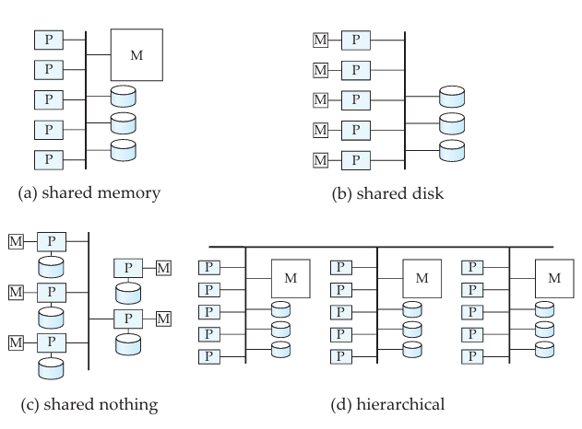

Slide 36
2. Shared Disk Architecture
(Also called: Cluster Architecture)
Structure
Each processor has its own private memory.
But all processors share the same disk system.
Communication happens via a network.
Advantages
Better fault tolerance
If one processor fails → others continue (because disks are common).
No contention for memory bus (unlike shared memory).
Good for medium-sized systems.
Disadvantages
Disk interconnection becomes a bottleneck
Many processors → heavy load on disk network
Slower communication (milliseconds) vs shared memory (nanoseconds).

Slide 37
3. Shared Nothing Architecture
(The most scalable approach — used in modern big data)
Structure
Each node has:
Its own processor
Its own memory
Its own disks
Nodes communicate only over a high-speed network.
Advantages
Highly scalable (can support 100s or 1000s of nodes)
Local disk access → fast I/O
Network capacity also increases when nodes increase
Disadvantages
Communication cost is high (data must move through network).
Non-local data access is slow.
More complex to program and manage.

Slide 38
4. Hierarchical Architecture
Combination of all three:
Why used?
To combine strengths and reduce weaknesses
Allows very large, complex systems to work efficiently

Slide 39
I/O Parallelism
When a database becomes very large, reading data from only one disk becomes slow. I/O Parallelism means dividing the data across multiple disks so that many disks can be read simultaneously, making retrieval faster.
Think of it like dividing a heavy load among many workers—work gets done faster.
The most common method to divide data is horizontal partitioning, where tuples (rows) are split across disks.
1 Data Partitioning Techniques
Parallel databases use three main strategies:
a. Round-Robin Partitioning
Distribute rows one-by-one across disks in rotation.
Example: Tuple 1 → Disk0, Tuple 2 → Disk1, Tuple 3 → Disk2, … repeat.

Slide 40
Pros
Very balanced distribution.
Good for scanning the entire table.
Cons
Not good for point queries or range queries, because: → You must check every disk.
b. Hash Partitioning
Uses a hash function on a chosen attribute (e.g., customer_id).
Example: If hash(customer_id) = 3 → tuple goes to Disk 3.

Slide 41
Pros
Excellent for point queries on partitioning attribute (Find customer with ID = 100 → hash to one disk only).
Even distribution if hash is good.
Good for scanning full relation.
Cons
Poor for range queries (example: salary between 20000 and 50000).
Poor for queries on non-partitioning attributes.

Slide 42
c. Range Partitioning
Data is divided based on value ranges of an attribute.
Example (3 disks):
Disk 0: values < 5
Disk 1: 5–40
Disk 2: >40
Pros
Excellent for range queries.
Good for point queries on the partitioning attribute.
Only relevant disks are searched → better throughput.
Cons
If many values fall into the same range → skew → some disks overloaded.

Slide 43
2. Comparison Summary
Operation Type | Round Robin | Hash | Range
Full Table Scan | Very good | Good | Good
Point Query | Poor | Best | Good
Range Query | Poor | Poor | Best

Slide 44
3. Handling Skew
Skew happens when some partitions get too many tuples → some disks overloaded. This reduces parallelism because the slowest disk decides the speed.
Types of Skew
Attribute-value skew Some values appear too frequently → all go to one partition.
Partition skew Design of partition ranges is poor → uneven distribution.
Effects
Reduced speedup.
Workload imbalance.
Certain processors become hot spots.

Slide 45
Methods to Reduce Skew
1. Balanced Partition Vector (for range partitioning)
Sort data by the partition attribute.
Divide after every 1/n portion.
Cons:
Requires initial sorting → extra I/O.
2. Histograms
Store frequency counts of attribute values.
Use histogram to divide ranges more evenly.
Stored in catalog for quick access.

Slide 46
3. Sampling
Take sample rows from relation.
Estimate distribution.
Create partitions approximately.
4. Virtual Processors Technique
Create many virtual processors (more than real processors).
Tuples assigned to virtual processors.
Virtual processors mapped to real ones in round-robin fashion.
Benefits
Even if a range is heavy, the virtual processors distribute the load.
Avoids hot spots.
Better parallelism.

Slide 47
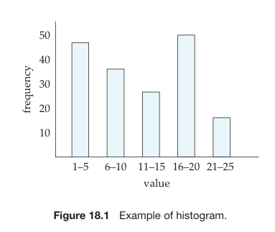

Slide 48
Interquery Parallelism
Interquery parallelism means running different queries or transactions at the same time on different processors.
It increases transaction throughput (more transactions per second). It does not reduce the response time of a single query.
Think of it like many customers standing at different counters in a bank. Each customer is served at a different counter (parallel), but one person's speed of service does not increase.
Why Interquery Parallelism Is Useful
When many users or applications are accessing the database simultaneously.
To scale up a system so it can handle more load.
Used heavily in OLTP systems (online transaction processing).

Slide 49
Where It Works Well
Shared-Memory Architecture
All processors share the same memory.
Very easy to support interquery parallelism.
Even traditional single-CPU databases already support concurrent execution.
So on shared-memory systems, supporting interquery parallelism requires little or no modification.
Where It Becomes Difficult
Shared-Disk and Shared-Nothing Architectures
Here, each processor has its own memory, and they must coordinate.
Main challenges:

Slide 50
1. Locking Coordination
Processors must share information so that:
Two processors do not update the same data at the same time.
Locks must be managed across processors.
This requires message passing for lock management.
2. Logging Coordination
All processors must maintain consistent logs for recovery.
3. Cache Coherency Problem
Each processor has its own buffer cache. The database must ensure that:
Every processor reads the latest version of a page.
If Processor P1 updates a data page, Processor P2 must not read an old copy.
Maintaining this correctness is called cache coherence.

Slide 51
Intraquery Parallelism
Intraquery parallelism means using multiple processors to run one single query faster.
This is mainly useful for long-running queries (like large sorting, joins, aggregations) where executing one query on a single processor would take too much time.
Why Do We Need Intraquery Parallelism?
Interquery parallelism only runs different queries at the same time.
It does NOT speed up the execution of one long query.
So for large OLAP queries (data analytics), we use intraquery parallelism.

Slide 52
How It Works?
A query is made up of operations in an operator tree (sort → project → join → etc.).
Intraquery parallelism works in two major ways:
1️⃣ Intra-operation parallelism
We parallelize a single operation.
Example: Sorting a relation
Suppose a relation is stored in multiple disks using range partitioning.
Each disk has a portion of the data.
We can sort each partition at the same time on different processors.
After that, the sorted partitions are concatenated to form the final sorted output.
Faster than sorting the whole relation sequentially.

Slide 53
2️⃣ Inter-operation parallelism
We run different operators of a query in parallel.
Example:
If a query has:
Select operation
Then a join
Then another operation
Some operations may not depend on each other directly → they can run in parallel.
Pipelining
If Operation A produces output that Operation B needs, we can run them together:
Processor 1: Runs Operation A
Processor 2: Immediately uses A's output and runs Operation B
Faster because B does not wait for A to complete fully.

Slide 54
Using Both Types Together
In real systems, both:
Intra-operation parallelism (parallelize one operation)
Inter-operation parallelism (parallelize multiple operations)
are combined to get the best speed.
Architecture Assumption
The algorithms usually assume a shared-nothing architecture:
n processors (P₀, P₁, …, Pn-1)
Each processor has its own disk (D₀, D₁, …, Dn-1)
Data movement between processors must be explicitly done through messages.

Slide 55
Summary
Intraquery parallelism = speeding up ONE query using multiple processors.
Two forms:
Intra-operation parallelism → parallelize each operator
Inter-operation parallelism → run multiple operators in parallel (also pipelining)
Used mainly for large analytical queries.

Slide 56
Distributed Data Storage
A distributed database stores data at multiple sites (locations) instead of keeping all data in one place.
There are two main methods to store a relation (table) across different sites:
Replication
Fragmentation
Sometimes both are combined together.

Slide 57
1. Data Replication (Copying the relation)
Replication means:
We store multiple copies of the same relation r at different sites.
If replication is done at every site → it is called full replication.
Advantages of Replication
1. High Availability
If one site fails, the system can use another copy available at a different site. ➡ System keeps working even during failures.
2. Faster Read Operations
If most queries are read-only, many sites can read copies in parallel. More replicas ⇒ Faster data access ⇒ Less data transfer between sites.

Slide 58
Disadvantage of Replication:
High Update Overhead
When data is changed, all replicas must be updated everywhere.
Example:
Suppose a bank account record is stored at 5 sites.
When balance changes, update must occur at all 5 sites.
This increases network traffic and complexity.
Because of this, distributed systems often use a primary copy:
One site is considered the “main” copy.
All updates go through this site.

Slide 59
2. Data Fragmentation (Splitting the relation)
Instead of copying the whole table, we split it into smaller parts (fragments). Each fragment is stored at a different site.
There are two types of fragmentation:
A. Horizontal Fragmentation
The rows (tuples) of the table are divided.
Each fragment contains some tuples, based on a condition.
The original table can be reconstructed by union of fragments.

Slide 60
Example:
A bank’s account table can be divided into:
account1 = accounts where branch = "Hillside"
account2 = accounts where branch = "Valleyview"
➡ Useful because data stays where it is used most → less data transfer.
General rule:
Fragment rᵢ = Pᵢ(r) (where Pᵢ is a selection predicate)
Reconstruction: r = r₁ ∪ r₂ ∪ … ∪ rₙ

Slide 61
B. Vertical Fragmentation
The columns (attributes) of the table are divided.
Each fragment contains some attributes.
To reconstruct the table, we use a natural join on a common key.
Example:
Employee table:
| employee_id | name | designation | salary |
To protect salary information, create:
employee_private_info → (employee_id, salary)
employee_public_info → (employee_id, name, designation)
Both have employee_id as common key.
➡ Reconstruction: employee_info = employee_private_info ⨝ employee_public_info

Slide 62
Combining Fragmentation + Replication
(used in real systems)
First horizontally fragment the table by branches.
Then replicate each fragment at two nearby sites.
This gives: faster access fault tolerance flexibility

Slide 63
3. Data Transparency
Users should not know or worry about where data is stored physically.
This is called data transparency.
It has 3 types:
A. Fragmentation Transparency
User does not need to know:
how a table is fragmented,
how many fragments exist,
where they are stored.
User simply writes:
SELECT * FROM account;

Slide 64
B. Replication Transparency
User does not know how many replicas exist.
System:
chooses nearest replica for read,
updates all replicas on write.
C. Location Transparency
User does not care where data physically resides.
User simply refers to table name:
SELECT * FROM employee;

Slide 65
Naming Problem in Distributed Databases
Different sites might accidentally use the same name for different data.
Two solutions:
1. Central Name Server
All names must be registered centrally.
Issues:
Single point of failure
Performance bottleneck

Slide 66
2. Site-ID Prefixing (Most Common)
Each site adds its own ID to names:
Examples:
site17.account
account@site17
No name conflict But location transparency is lost.
Solution: Aliases
System allows simple alternative names.
Example:
Actual name: account@site17
Alias: account
User uses alias → System maps it internally.
Provides full location transparency.

Slide 67
Summary
Replication = storing multiple copies of a table.
Pros → high availability, fast reads
Cons → high update cost
Fragmentation = splitting a table into fragments.
Types → horizontal (rows), vertical (columns)
Transparency = user is unaware of where/how data is stored
Types → fragmentation, replication, location

Slide 68
Distributed Transactions
In a distributed database system, data is stored at multiple sites (locations). To access or update this data, we use transactions. Just like in a centralized database, all transactions must follow ACID properties:
Atomicity
Consistency
Isolation
Durability
But ensuring ACID properties becomes much harder when a transaction involves many sites.

Slide 69
Types of Transactions
1. Local Transactions
Access data from only one site.
Example: A transaction that updates data in the Mumbai database only.
Easy to handle using normal techniques (like chapters 14, 15, and 16 mention).
2. Global Transactions
Access data from multiple sites.
Example: A bank transfer where account info is in Delhi database but transaction logs are in Bengaluru database.
Much more complex because:
Many sites must respond.
A single failure may break the transaction.
All sites must commit or abort together.

Slide 70
System Structure (Simple View)
Each site in a distributed database has two important subsystems:
1. Transaction Manager (TM)
Works at the local site.
✔ Responsibilities:
Executes local transactions or subtransactions of global transactions.
Maintains log files for recovery.
Takes part in concurrency control to manage simultaneous operations.
Similar to the transaction manager in a centralized DB, but must work with other sites.

Slide 71
2. Transaction Coordinator (TC)
Works for transactions initiated at that site.
✔ Responsibilities:
Starts a transaction.
Breaks it into smaller pieces called subtransactions.
Sends subtransactions to appropriate sites.
At the end, coordinates commit or abort across all sites.
📝 Without the coordinator, a global transaction cannot be completed in a controlled manner.

Slide 72
How It Works – Simple Example
Assume a global transaction T1 needs data from Site A and Site B.
Transaction starts at Site A → Coordinator at A
Coordinator divides T1 into:
T1A → goes to Site A
T1B → goes to Site B
Each site’s Transaction Manager executes its part.
Coordinator performs:
Final decision: Commit everywhere or Abort everywhere
This ensures Atomicity across the whole distributed system.

Slide 73
2. System Failure Modes in Distributed DB
Distributed systems face all normal failures, plus additional ones. Here are the 4 main failure modes:
1. Site Failure
A whole machine/site crashes.
Examples:
Power failure
OS crash
Hardware failure
Impact:
The site becomes unreachable.
Transactions involving that site may fail or get blocked.

Slide 74
2. Loss of Messages
Messages between sites may be:
Lost
Corrupted
Duplicated
Even though protocols like TCP/IP try to ensure safe delivery, failures can still happen.
3. Communication Link Failure
The physical or network connection between two sites breaks.
Effects:
Messages cannot travel through that link.
System tries to reroute messages via other links (if available).

Slide 75
4. Network Partition
A serious condition where the network splits into two or more groups of sites.
Example:
Sites {A, B} get separated from sites {C, D}
No communication between the groups
Each group may continue working independently
Important Note: A partition may even be a single isolated node.
Why Failures Are Critical?
Because global transactions need:
All sites to communicate
All sites to coordinate commit/abort
Any failure (even a small one) can cause:
Incomplete transactions
Inconsistency
Deadlocks
Data loss if systems are not designed properly

Slide 76
Commit Protocols
In distributed transactions, a single transaction may run on multiple sites.
To satisfy Atomicity (A of ACID):
The transaction must commit at all sites OR
The transaction must abort at all sites
No mixed outcome is allowed.
To achieve this coordination, we use Commit Protocols.
Commit protocols are rules that ensure every site agrees on the final result.

Slide 77
Why Do We Need Commit Protocols?
Because in distributed systems:
Sites may fail
Messages may not reach
Network may break
Without a clear protocol, some sites may commit, others may abort → data inconsistency.
Commit protocols make sure that all sites reach the same decision.

Slide 78
Two-Phase Commit (2PC) – Simple Explanation
The Two-Phase Commit protocol is used to make sure that all sites participating in a distributed transaction either commit together or abort together — ensuring atomicity.
Suppose a transaction T is started at site Si, and its transaction coordinator is Ci.
When T finishes execution at all sites, Ci starts 2PC.
Phase 1: Prepare Phase (Voting Phase)
Step 1 — Coordinator Actions
Coordinator Ci writes a log entry: <prepare T>
Ci forces this log entry to stable storage (so it survives crashes)
Ci sends the message: prepare T → to all sites where T executed

Slide 79
Step 2 — Actions at Each Participant Site
Each site receives prepare T and must decide:
Can I commit my part of T?
The site checks:
Are all operations completed?
Any errors?
Any local problems?
If site decides NO:
Writes <no T> to log
Sends abort T to the coordinator
If site decides YES:
Writes <ready T> to log
Forces all log records of T to stable storage
Sends ready T to the coordinator
After a site sends ready T, it is in the READY state, meaning:
It cannot abort on its own
It must wait for the coordinator’s decision
It must hold all locks until the final commit/abort

Slide 80
Phase 2: Commit/Abort Phase (Decision Phase)
The coordinator waits for:
Responses from all sites
Or until a timeout happens
Coordinator decides outcome:
If ALL sites replied YES / ready T
→ Ci writes <commit T> to log → Forces log to stable storage → Sends commit T to all sites
If any site replied NO / abort T
→ Ci writes <abort T> to log → Forces log to stable storage → Sends abort T to all sites
Once Ci writes commit/abort to the log and forces it, the decision is final.

Slide 81
Distributed Query Processing
When a query is run in a distributed database, the data may be stored at different sites. Processing such queries requires extra considerations compared to a centralized DBMS.
In a distributed system, the query optimizer must balance:
Disk access cost
Network data-transfer cost
Parallel processing benefits
Because sending data across the network is sometimes slow and expensive.

Slide 82
Query Transformation
Suppose we run this query:
Find all tuples from the account relation
But the account relation may be:
Fragmented
Replicated
Or both
Example:
account = account1 ∪ account2

Slide 83
If the user writes:
σbranch_name = "Hillside" (account)
After fragmentation expansion, it becomes:
σbranch="Hillside"(account1 ∪ account2)
Using relational algebra rules:
σcond(r1 ∪ r2) = σcond(r1) ∪ σcond(r2)
So:
σbranch="Hillside"(account1) ∪ σbranch="Hillside"(account2)

Slide 84
Multidimensional Databases
A Multidimensional Database is a type of database optimized for fast analysis of large amounts of data. Instead of storing data in 2-D tables (rows and columns), it stores data in a multidimensional cube.
These multidimensional structures are also called:
OLAP Cubes (Online Analytical Processing Cubes)
Data Cubes
MDDBs are mainly used in data warehouses and business intelligence systems.

Slide 85
A Multidimensional Data Model is defined as a model that allows data to be organized and viewed in multiple dimensions, such as product, time and location
Features of Multidimensional data model
It allows users to ask analytical questions associated with multiple dimensions which help us know market or business trends.
OLAP (online analytical processing) and data warehousing uses multidimensional databases.
It represents data in the form of data cubes. Data cubes allow to model and view the data from many dimensions and perspectives.
It is defined by dimensions and facts and is represented by a fact table. Facts are numerical measures and fact tables contain measures of the related dimensional tables or names of the facts.

Slide 86
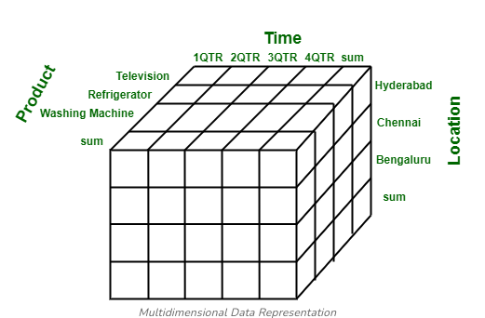

Slide 87
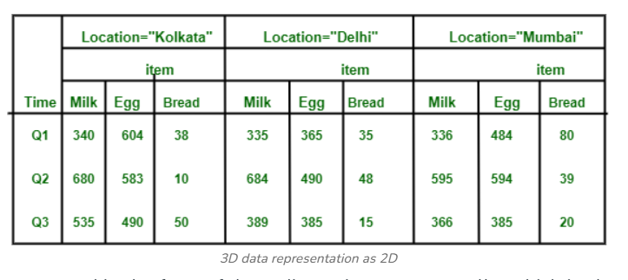
Multidimensional databases (MDDBs) are essential in data analytics, data warehousing, and business intelligence.
They allow organizations to analyze data from multiple dimensions, identify patterns, trends, and make data-driven decisions quickly.

Slide 88
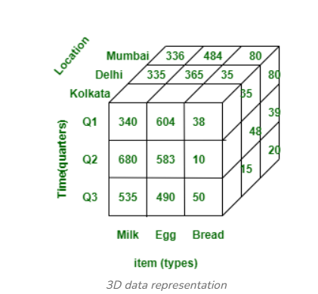

Slide 89
Introduction To Temporal Database
A Temporal Database is a database that stores time-dependent information. It keeps track of historical data, current data, and sometimes future data.
Traditional databases keep only the latest value. Temporal databases store:
What the data was in the past
What it is in the present
(Sometimes) What it will be in the future

Slide 90
Introduction to Temporality
Temporality = “related to time”.
In databases, temporality means:
Data changes over time
Example: An employee’s salary:
Salary | From Date | To Date
25,000 | 01-01-2020 | 31-12-2021
30,000 | 01-01-2022 | CURRENT

Slide 91
Types of Time in Temporal Databases
Valid Time (Real-World Time)
This is the time when a fact is true in the real world.
For example:
This means:
➡ Amit was actually the Sales Manager from 2018 to 2022 in the real world.
Valid time cannot be automatically generated by the system. It must be given by the user, because the DBMS does not know real-world timelines.
Department | Manager | Valid From | Valid To
Sales | Amit | 2018 | 2022

Slide 92
2. Transaction Time (Database Time)
This is the time interval during which the fact is stored in the database.
Example:
If the record was inserted on 10 March 2023, the transaction time begins on that date.
Even if valid time was 2018–2022, transaction time may be 2023 onwards.
Transaction time is automatically generated by the DBMS. It depends on the transaction order, logs, and serialization.

Slide 93
3. Bitemporal Data
If a database stores:
Valid time
Transaction time
for the same tuple, it becomes a bitemporal relation.
This means the system knows:
When a fact was true in the real world
When the database recorded or changed it
Used in systems requiring full history + audit (banking, insurance, government records).

Slide 94
What Is a Temporal Relation?
A temporal relation is a relation where each tuple has one (or both) types of time:
Valid-time temporal relation
Transaction-time temporal relation
Bitemporal relation (both times)
Each tuple is repeated for every time interval during which it is true.
Example (Simplified)
A table storing employee departments over time:

Slide 95
Here:
First row is true from 2018 to 2020
Second row is true from 2021 to present (‘*’ means current)
Internally, times are not stored as text. They are stored in numeric or timestamp form, like:
Number of seconds since Jan 1, 1900
Unix timestamp
DBMS-native datetime format
This makes comparison and indexing faster.
EmpID | Dept | From | To
101 | Sales | 2018-01-01 | 2020-12-31
101 | HR | 2021-01-01 | *

Slide 96
Why Are Temporal Databases Important?
They allow answering questions like:
“What was the price of this product in 2020?”
“Who was the manager of HR Department in May 2019?”
“Show all changes made in this patient’s medical record.”
“What were the previous readings of a sensor before failure?”
These are impossible to answer if past states are not stored.

Slide 97
Spatial and Geographic Data
Spatial data refers to any data that represents objects or locations in space — such as roads on a map, shapes of buildings, or boundaries of land.
Traditional databases are not built to handle spatial queries efficiently. For example:
Find all polygons that intersect a given polygon.
Such queries involve geometric shapes, not simple numbers or strings, so we need special support for storage, indexing, and querying of spatial information.

Slide 98
Two Important Types of Spatial Data
Spatial data can be divided into two major categories:
1. Computer-Aided Design (CAD) Data
Used in engineering and design. Examples include:
Building layouts
Car, aircraft, or machine designs
Electronic circuits and chip layouts
These applications store precise geometric shapes — points, lines, arcs, and curves.

Slide 99
2. Geographic Data (GIS Data)
GIS = Geographic Information Systems Used in map-based applications.
Examples:
Road maps
Land-usage maps
Elevation maps
Political boundaries
Land ownership plots
Forest cover maps
Flood-zone maps
Modern databases like Oracle Spatial, IBM DB2 Spatial Extender, Informix Spatial DataBlade support GIS data.

